Slide 1
PERSoNAL SPECIALIZATION PROJECT
HRISTO KOLEV

Slide 2
TABLE OF CONTENTS
1
INTRODUCTION
2
MALWARE SCRIPT
3
PASSWORD MANAGER
4
DEMO

Slide 3
1
INRODUCTION

Slide 4

ABOUT THE ASSIGNMENT
List with the completed tasks:
MALWARE SCRIPT
PASSWORD MANAGER
And the most important thing: THIS IS FOR EDUCATIONAL PURPOSE!

Slide 5


What is malware?
What is password manager?
Notes:
Malware: This is a software designed to cause disruption to a computer, server, network, leak data, gain unauthorized access to information or system etc.
Pass manager: This is a computer program that allows users to store and manage passwords for local apps or for social medias, websites, webshops, etc.

Slide 6
2
MALWARE SCRIPT
2

Slide 7

MAIN GOAL
PLANNING
PROGRAMMING LANGUAGE

Slide 8
How to create malware script to infiltrate a victim’s machine?
Which programming language is the best for malware and why?
How to establish connection between server and client?
Research
Notes:
Socket: is a software structure of a computer network that serves as an endpoint for sending and receiving data across the network.
Python is used for malware because of it’s flexibility, ease of use, libraries and tools

Slide 9
4
PASSWORD MANAGER
3

Slide 10

MAIN GOAL
PLANNING
PROGRAMMING LANGUAGE

Slide 11
Research
How to create valid password manager?
Which programming language is the best for password manager and why?
How to keep the passwords safe?

Slide 12
5
DEMO
4

Slide 13
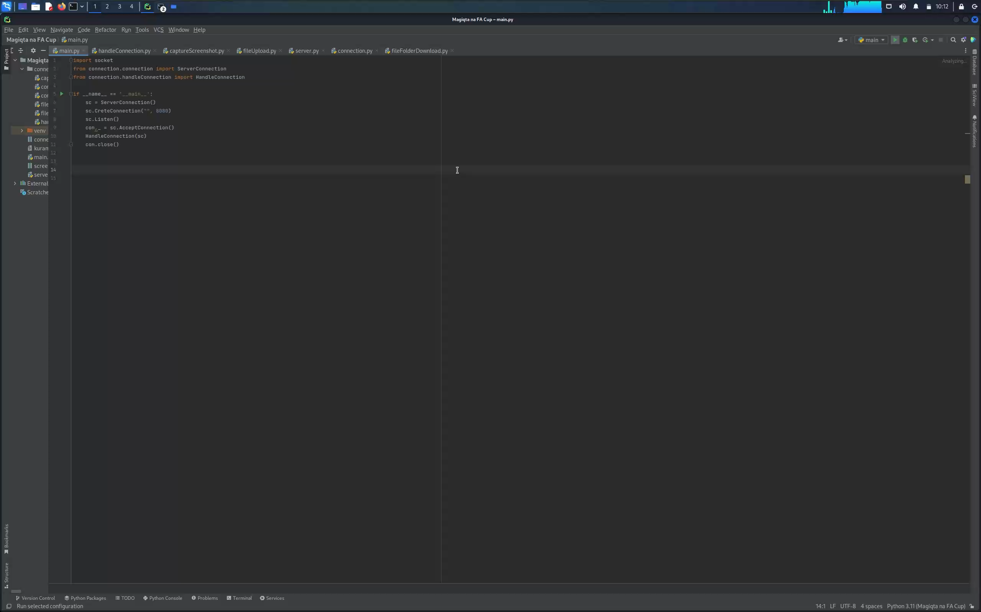

Slide 14
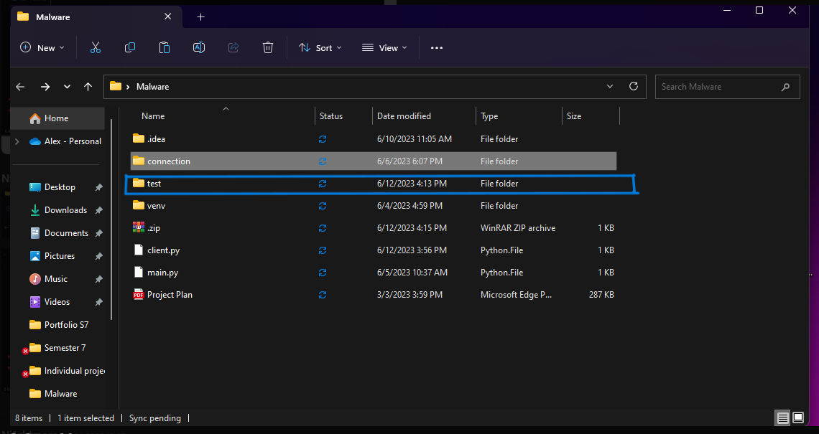
Proof of working product

Slide 15
THANK YOU FOR THE ATTENTION!

